Slide 1
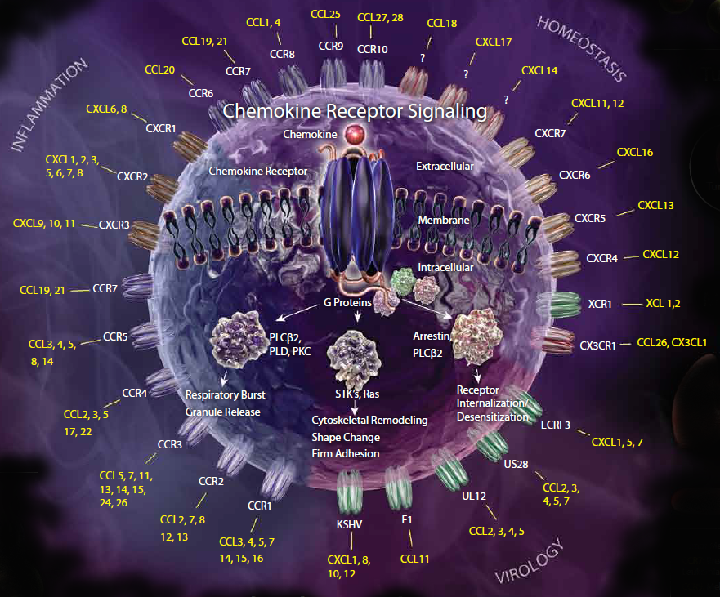
Chemokine Receptors
®

