Slide 1
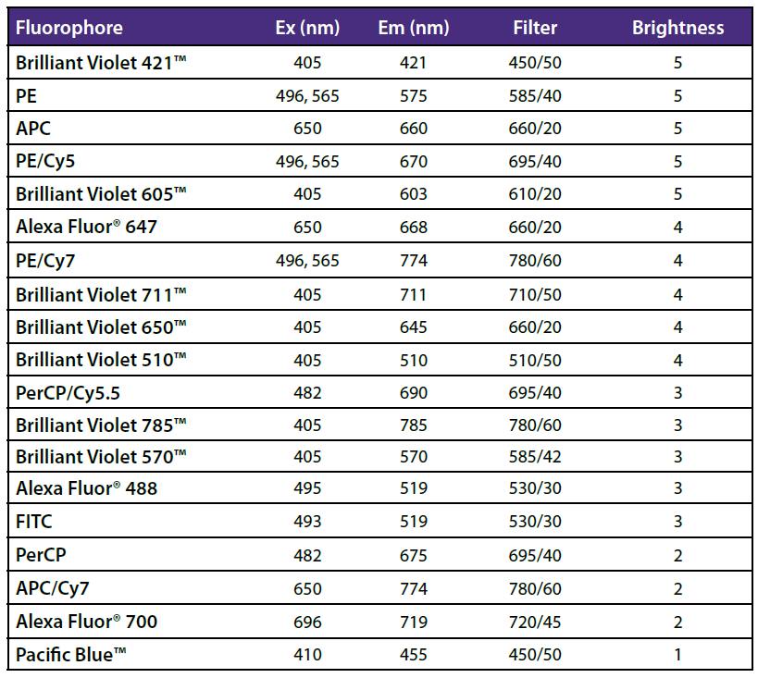
Fluorophore Brightness Index
The Fluorophore Brightness Index Score is a relative indication of fluorescence intensity above the background for each fluorophore antibody conjugation (1=dim, 5=brightest).
Factors affecting brightness:
Flow cytometer
The instrument configuration
Laser power
Antibody clone
Antigen target
F/P ratios
Buffer conditions
Cell type/treatments
®

