Slide 1
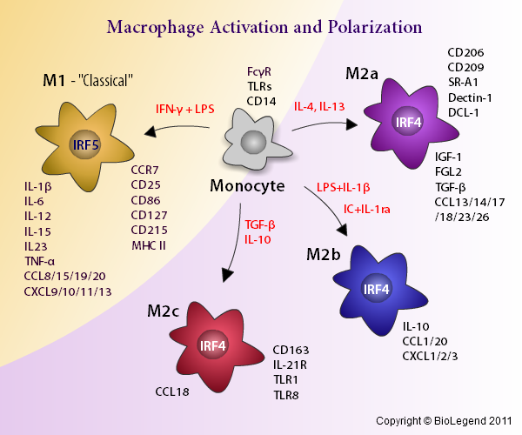
Macrophage Polarization
®
Notes:
.

