Slide 1
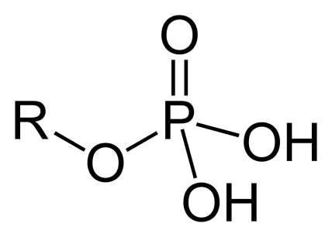
Phosphorylation
Addition of a phosphate (PO₄) group to a protein or other organic molecule.
Phosphorylation activates or deactivates many protein enzymes, estimated that as much as half of all cellular proteins can be phosphorylated.
Kinase – protein that adds phosphate groups to another protein.
Phosphatase – protein that removes phosphate groups.
Regulatory roles of phosphorylation include:
Mediates enzyme inhibition
Important for protein-protein interaction via recognition domains.
Important in protein degradation
Biological thermodynamics of energy-requiring reactions
®
Notes:
.

