Slide 1
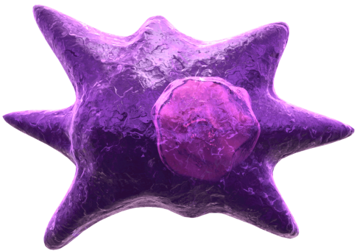
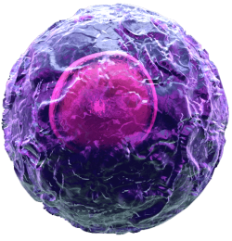
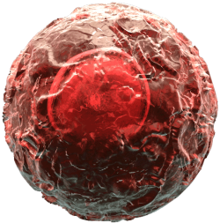
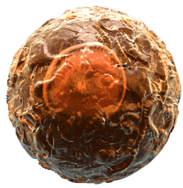
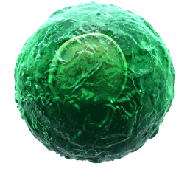
TSLP and Th2 Cells
No Effect
Epithelial Cells
TSLP
Th2 Mediated Inflammation
Th1
Th17
IL-4
TSLP
Dendritic Cell
TSLP
MHC II
TCR
TSLPR
Bcl-2
Proliferation
Antigen
Th2
Naïve T cell
Kitajima, M., et al. 2011. Eur. J. Immunol. 41:1862.
®
Notes:
In the presence of TCR engagement and TSLP, naïve T cells are capable of differentiating into Th2 cells. Kitajima et al. found that Th2 cells tend to naturally express higher levels of TSLP Receptor compared to Th1 or Th17 cells. TSLP also stimulates IL-4 production from Th2 cells. This, in turn, induces TSLP production from epithelial cells of the skin, lung, and gut. In a positive feedback loop manner, TSLP can then increase Th2 cell proliferation and expression of Bcl-2, an anti-apoptotic protein. These same effects were not observed on Th1 or Th17 cells. Kitajima’s results indicate TSLP promotes the amplification of allergic inflammation by enhancing the Th2 cell response.

