Slide 1
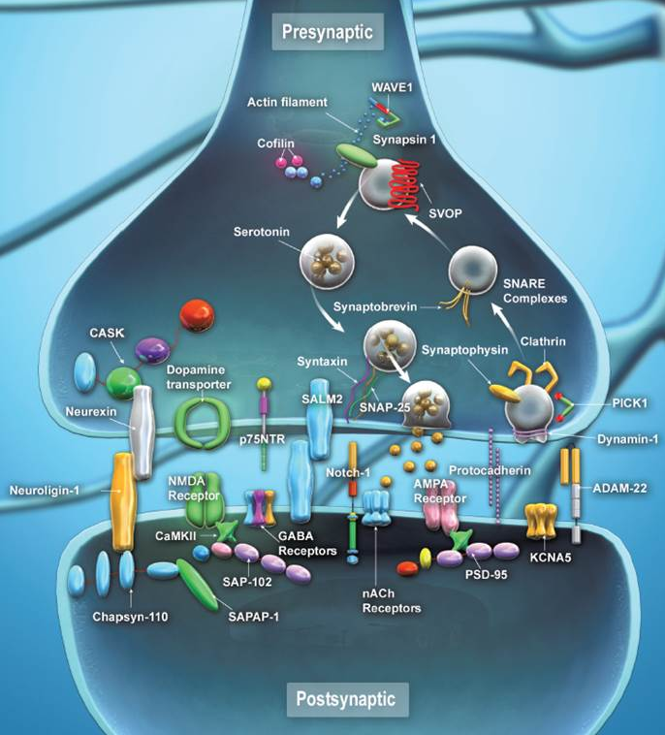
The Synapse
The neural synapse allows chemical or electrical signal transmission between neurons.
In a chemical synapse, the axon terminal of the presynaptic neuron packages neurotransmitters into synaptic vesicles.
Calcium ions trigger the fusion of synaptic vesicles to the presynaptic membrane, releasing its cargo into the synaptic cleft.
Neurotransmitter receptors on the dendrite of the postsynaptic neuron receive these signals, which are processed in the postsynaptic density.
®

